Slide 1

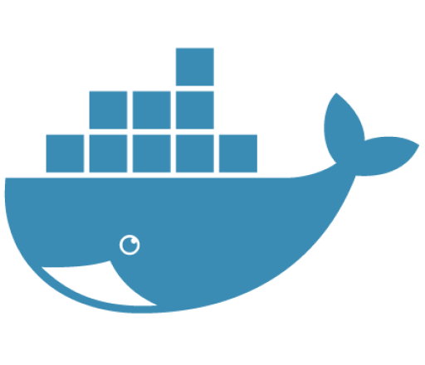
Docker
Build, Ship and Run

Slide 2
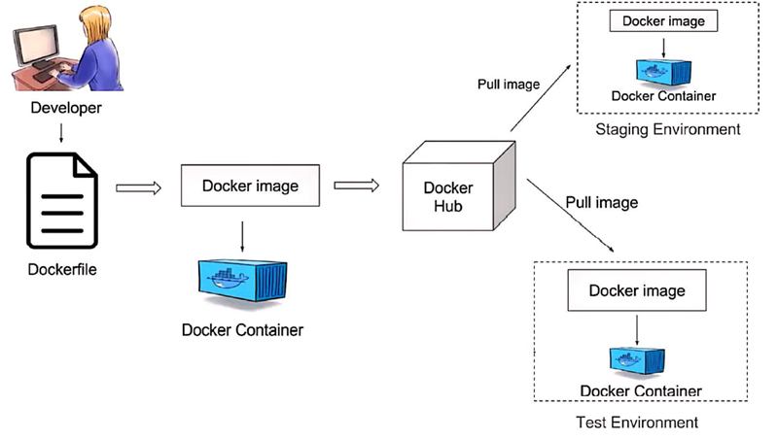
What is Docker?
Docker is an open platform for developing, shipping and running applications.
It packages an application along with all its dependencies into a container, ensuring consistency across different environments.
Think of a laptop box. It contains a laptop, a charger, a power cable, and a battery. The laptop is dependent on the charger and its accessories. This laptop box has everything that the laptop needs to run. After packing it, we can ship and use it anywhere.
Official Documentation
https://docs.docker.com/desktop/install/windows-install/

Slide 3

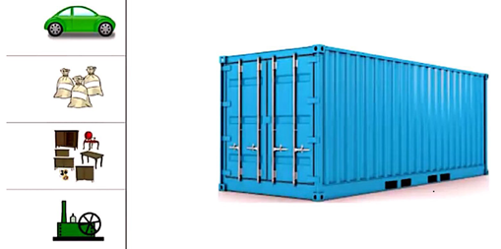
Why we need Container?
Consider a classical problem in the shipping industry :
We have items of different shapes, characteristics. Some are fragile, some are hard and there is no standardized way to package these items. What do we do?
This is where a CONTAINER can help!
No matter what the item, we can package it in this container and transport it from the source to the destination without any changes. Now map the same scenario to the Software Industry. We need a standardized way to package the application with its dependencies and deploy it on any environment. The docker with its containers does exactly that.

Slide 4
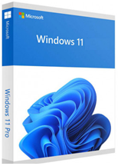
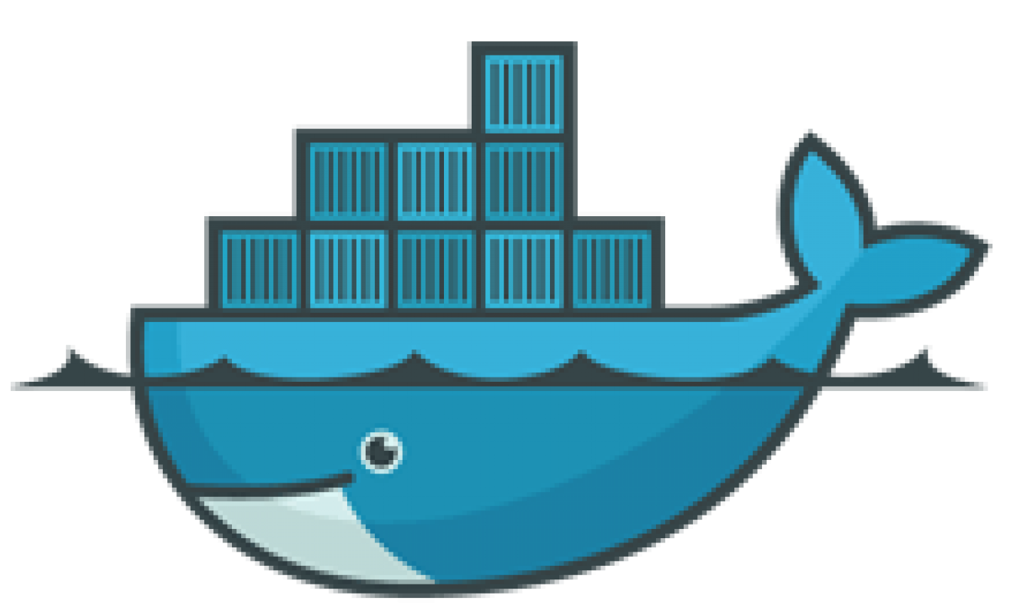
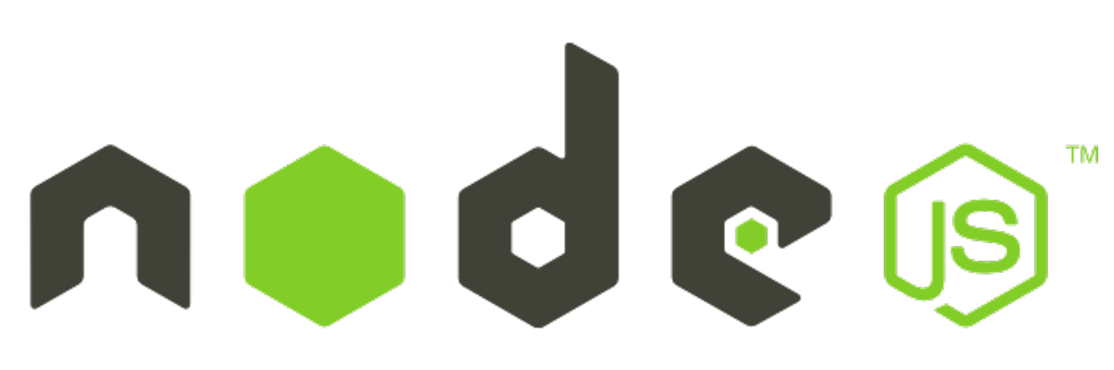

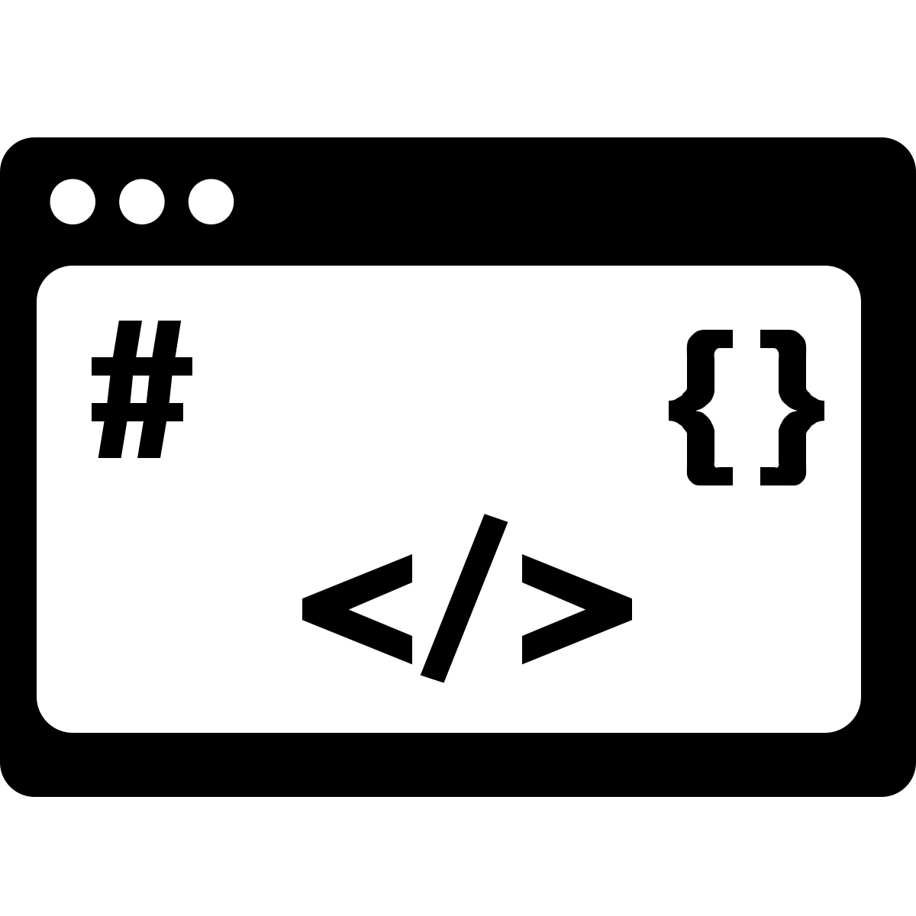

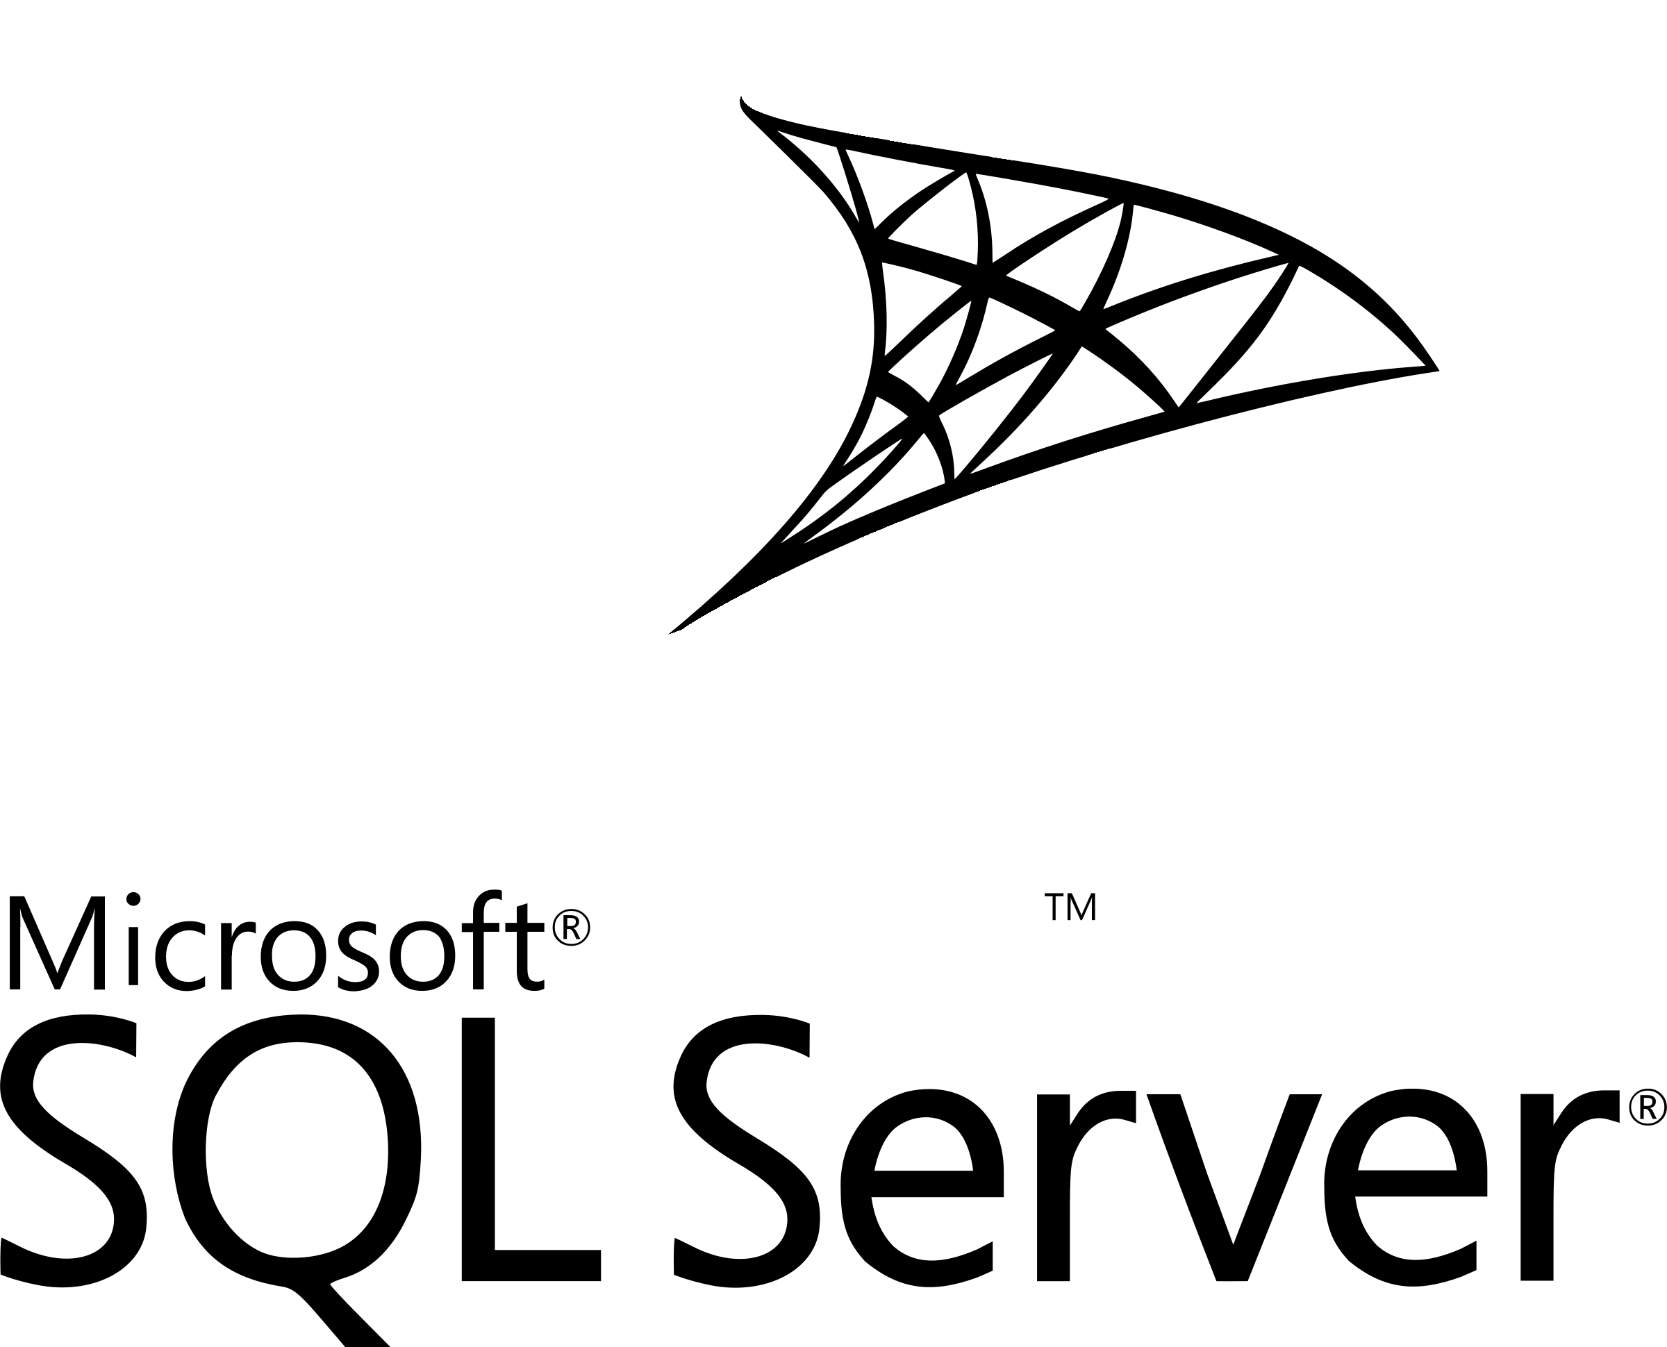
Dockerfile, Image and Container in Docker?
A Docker image is a template used to create containers, which are lightweight, independent, and self-contained packages. The image includes the application code, dependencies, libraries, and runtime, making it easy to deploy multiple containers.
Docker images are immutable, meaning they cannot be altered once created, and are built using a Dockerfile, which contains the instructions for image creation.
A container is a lightweight, isolated unit that runs the application and its dependencies, serving as a live instance of the Docker image. Containers utilize only the components necessary for execution, making them portable, efficient, and easy to run across different environments.
Image
Windows 11 Image
Container
Container
Container
Windows 11
Windows 11
Windows 11

Slide 5
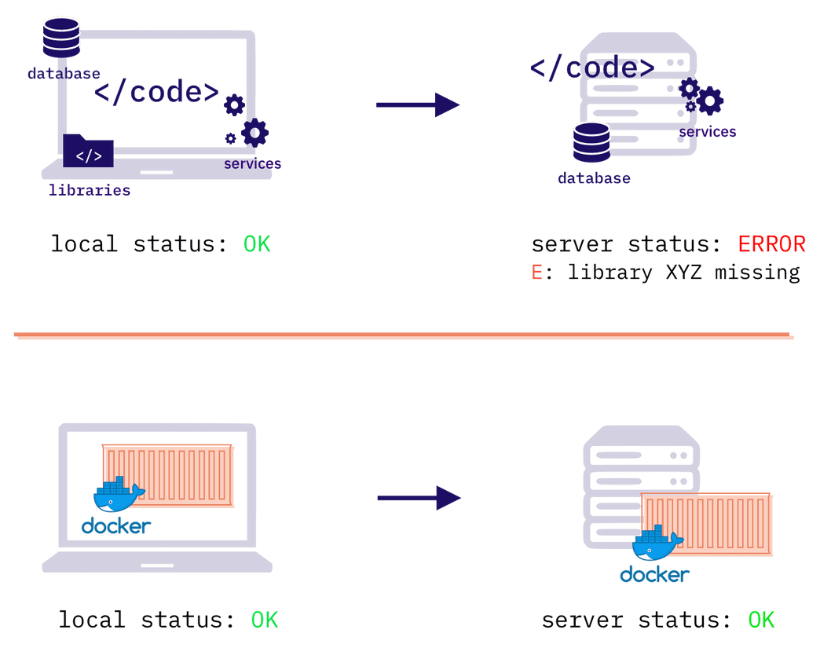
What problems docker solve?
Make your app behave in a consistent and predictable way in all environments
Problem: Ever heard of a famous developers’ excuse “It worked on my machine”? The fact that something works on a developer's computer is not a guarantee that it will work on your server. There may be some library or a tool missing, or a mismatch in required versions of installed software. Each computer or server is different, and configured in a different way. Without Docker you have to set up each of the machines and system manually, and this is time consuming and error prone.
Solution: Docker solves this problem with bundling not only the code, but all the parts required to run the application or website. These parts are closed inside the Docker containers, which are isolated and independent from the outside world. And this makes them run in the same, consistent and predictable way everywhere. This means less time spent on fixing issues and more time spent on delivering new features.

Slide 6
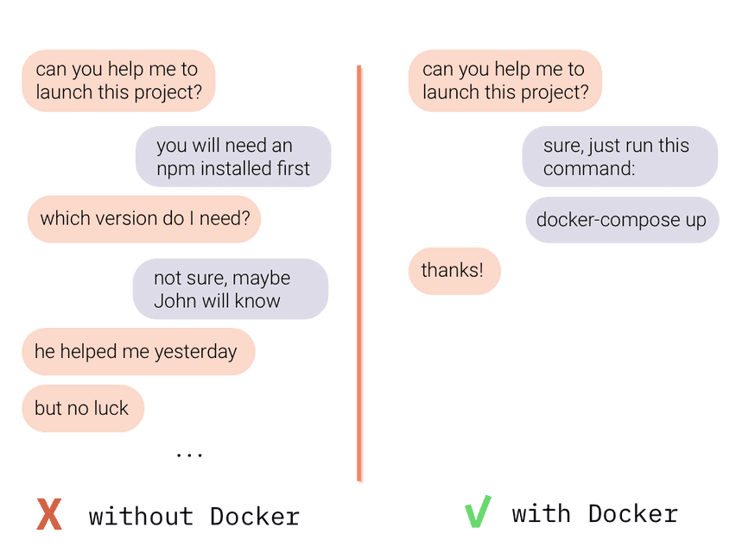
What problems docker solve?
Easily introduce new developers to your project
Problem: How quickly a new developer can start working on your product? Assuming he already has code on his machine, he still has to install some local server, set up a database, install required libraries, third party software, and configure it all together. How long does it take? From a few hours to many days. Even if your project has a good onboarding manual that explains all the steps, there is a high chance that it won’t work for every laptop and system configuration. Usually, onboarding a new developer is a collaborative effort of the whole team that helps the newcomer to install all missing parts and resolve all system issues.
Solution: With Docker all these manual installation & configuration steps are done automatically inside the Docker container. So it is as simple as launching Docker and running one command (docker-compose up), that will do all the work for the developer. No matter if he uses Docker on macOS (macOS with M1 chip), Windows or Linux.

Slide 7
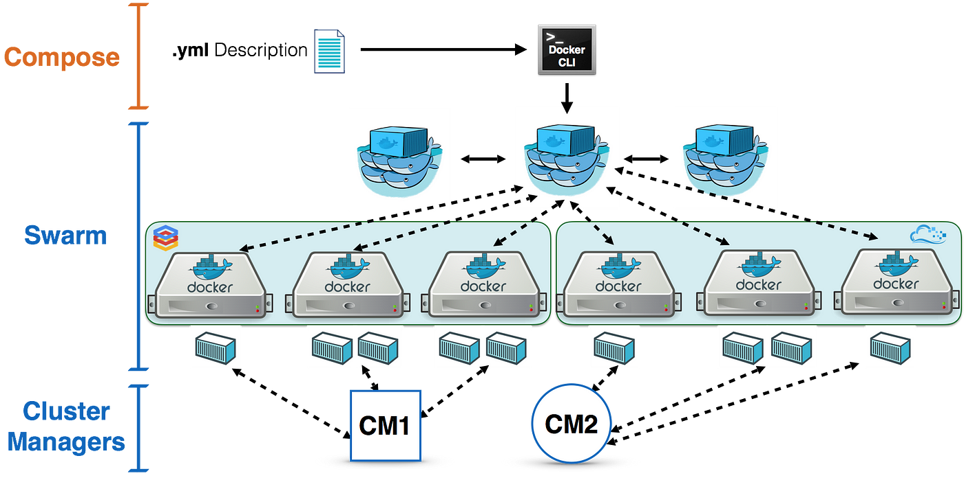
What problems docker solve?
Host your app wherever you want with no vendor locking
Problem: Scaling applications to meet user demand often requires complex setup and configuration across multiple machines or cloud services.
Solution: Website or web application bundled into a Docker container is similar to a stuff packed inside a freight container. Docker containers, same as cargo ones, are standardized, so most of the computers, servers and cloud (as container ship, freight trains, trucks) can handle them. This gives you a great flexibility on the hosting technology and provider. You can start with a small and cheap server, and scale when needed into another machine or to the cloud. And what’s more, you won’t get stuck with one hosting vendor. Docker containers are lightweight and can be easily scaled across multiple machines or cloud platforms using orchestration tools like Docker Swarm or Kubernetes.

Slide 8
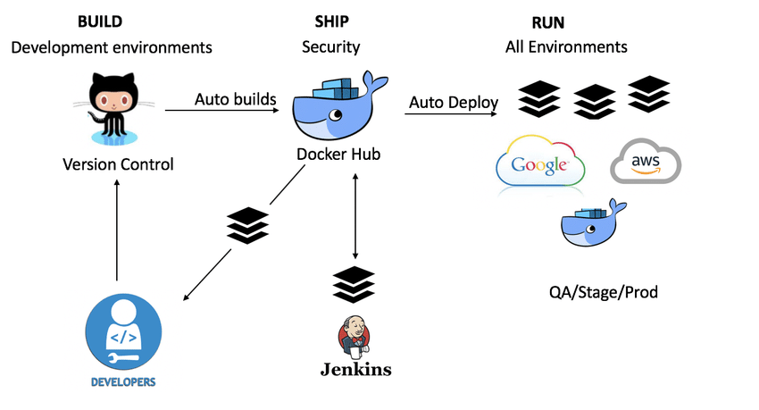
What problems docker solve?
Faster Development and Deployment
Problem: Traditional methods of setting up development environments and deploying applications can be slow and error-prone.
Solution: Docker allows for faster CI/CD pipelines by providing easy-to-set-up development environments and automating deployment processes. Containers start quickly, making the development, testing, and deployment cycles more efficient.

Slide 9
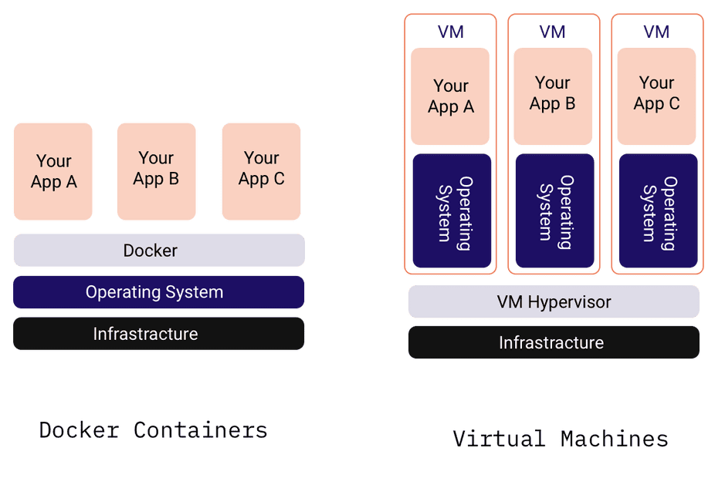
How is docker different from Virtual Machines?
Each virtual machine requires a separate operating system (like Windows or Linux) installed inside of it. And operating systems are not the lightest pieces of software. So if you have a couple of VM’s it may get quite heavy (both when it comes to the disk size and computing resources).
Docker containers instead of having its own system, use the operating system of the computer/server on which Docker is installed. The whole magic of Docker engine is that it enables computer resources to the containers, as if each docker container had access to its own operating system.
In other words, each VM has its own cargo ship that carries it, while docker containers can be carried in bulk on one ship.

Slide 10
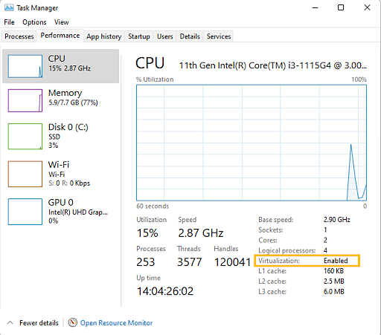
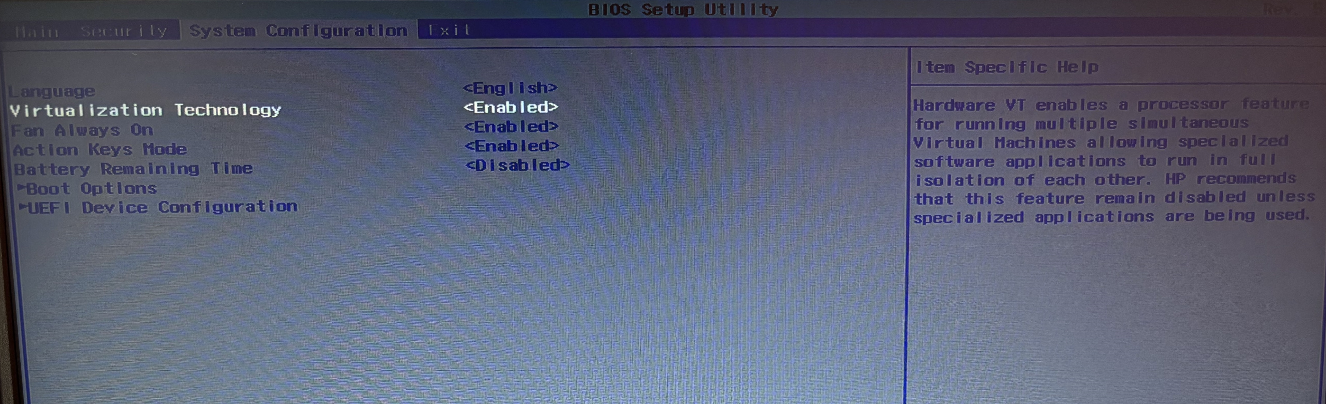
Install Docker Desktop on Windows
Enable Virtualization in Windows 10/11
Check if virtualization is enabled on Windows 10/11 through the Performance Tab of the Task Manager (CTRL + SHIFT + ESC)
If Virtualization is Disabled, follow these steps to enable it in BIOS or UEFI settings.
Reboot the computer
While the system is restarting from a black screen, enter BIOS by pressing the hotkey. The hotkeys differ depending on the brand of the computer used. Usually F1, F2, F3, F10, Esc or Delete keys are the hotkeys to enter BIOS
Navigate to Advanced Tab and press Enter to continue
Select Virtualization and Enable
Save changes and reboot the computer

Slide 11
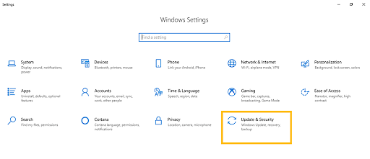
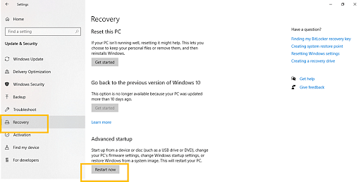
Install Docker Desktop on Windows
Enable Virtualization in Windows 10/11
BIOS can also be accessed through Windows in Settings
Go to Windows Settings
Click on Update and Security
Click on Restart Now from the Recovery Tab to enter Windows Recovery Environment
Click Troubleshoot > Advanced > UEFI Firmware Settings.
To continue, click Restart
BIOS Settings will be displayed. Select Virtualization and enable it

Slide 12
Install Docker Desktop on Windows
Enable Virtualization in Windows 10/11
To enable Virtualization without opening BIOS, follow these steps:
Navigate to the Security tab and press Enter on CPU Setup
Select Intel(R) Virtualization Technology and press Enter
Choose Enable and press Enter
Press F10
Press Enter to select Yes to save the settings and Boot into Windows

Slide 13
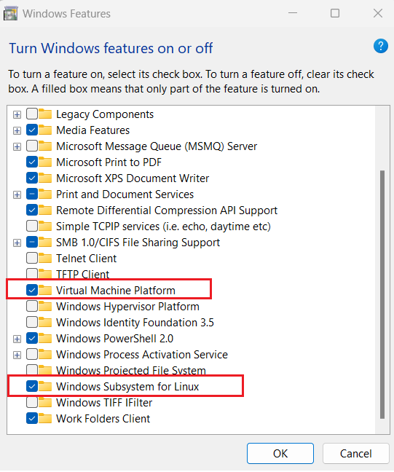
Install Docker Desktop on Windows
Turn on the WSL 2 feature on Windows
The WSL stands for the Windows Subsystem for the Linux. The Windows Subsystem for Linux (WSL) lets developers install a Linux distribution (such as Ubuntu, OpenSUSE, Kali, Debian, Arch Linux, etc.) and use Linux applications, utilities, and Bash command-line tools directly on Windows, unmodified, without the overhead of a traditional virtual machine or dual boot setup. Developers can access the power of both Windows and Linux at the same time on a Windows machine.
Turn On the WSL2 feature on Windows
Open ‘Turn Windows features on or off’ on your Windows Computer. Needs to enable Windows Features before installing any Linux distributions on Windows. Click on ‘Start’, search for ‘Turn Windows features on or off –> Open.
Enable ‘Virtual Machine Platform‘ and ‘Windows Subsystems for Linux’ features by enabling check mark and click on ‘OK‘.
Restart Computer

Slide 14
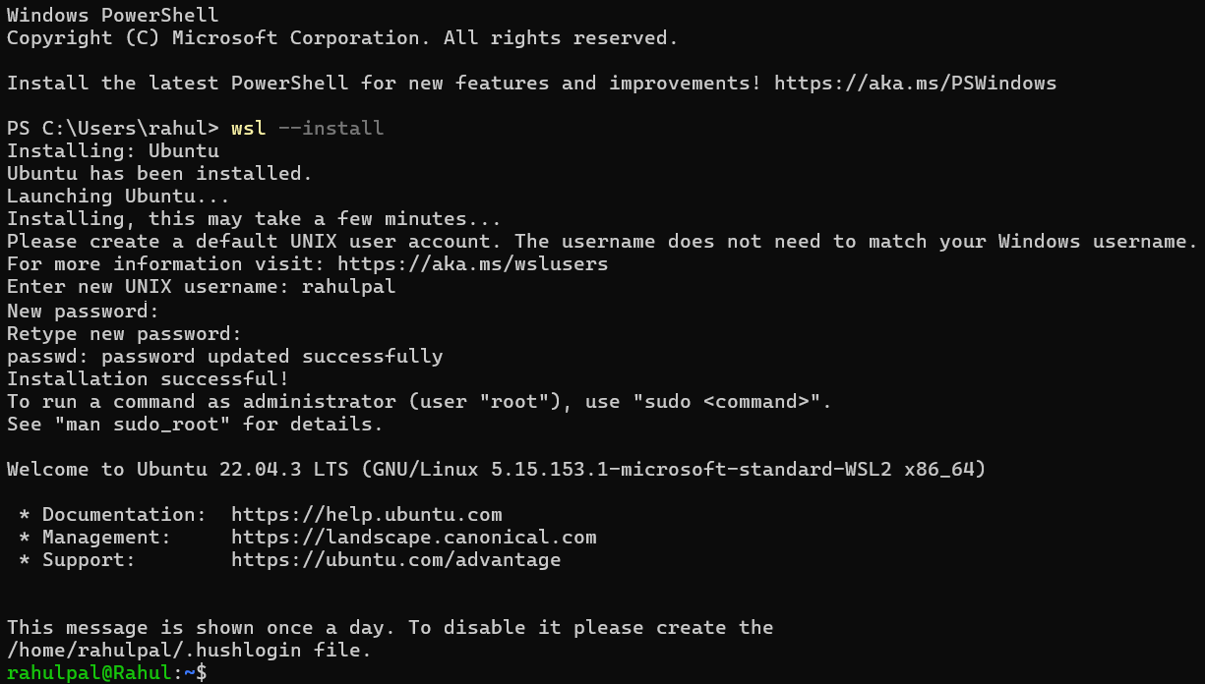
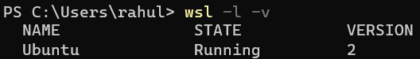
Install Docker Desktop on Windows
Install WSL
Install WSL Command
Open PowerShell or Windows Command Prompt in administrator mode by right-clicking and selecting “Run as administrator”, enter the command, then restart your machine.
Now set the version of the WSL from 1 to 2
If the current version of the WSL is 1 then we need to upgrade it to 2. With the current Ubuntu distribution, the version is already 2. We can check the version and status of all the distributions using the following command:
To change versions, use the command: wsl --set-version <distro name> 2 replacing <distro name> with the name of the Linux distribution that you want to update. For example, wsl --set-version Ubuntu-22.04 3 will set your Ubuntu distribution to use WSL 2.

Slide 15
Install Docker Desktop on Windows
Step-By-Step Docker Installation on Windows
Install from the Installer
Go to the website https://docs.docker.com/docker-for-windows/install/ and download the docker file.
Then, double-click on the Docker Desktop Installer.exe to run the installer.
Then click OK and simply follow the instructions on wizard and continue for the authorized installation process.
Ensure that your docker user account and administrator account should be the same, otherwise you need to add your user account to the docker user group
Install from the command line
To run in terminal,
"Docker Desktop Installer.exe" install.
For Powershell,
Start-Process '.\win\build\Docker Desktop Installer.exe' -Wait install
For windows command prompt,
start /w "" "Docker Desktop Installer.exe" install
To add user accounts into docker user groups especially when your admin account and user account are not the same.
net localgroup docker-users <users>/add
Verification
To verify the docker installation and versions, you can use following command lines,
With windows terminal via command prompt,
docker-run

Slide 16
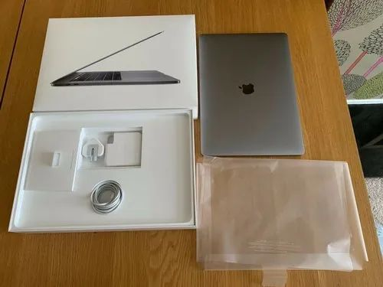
Docker Desktop
Why Create Docker images?
Think of a laptop box. It contains a laptop, a charger, a power cable, and a battery. The laptop is dependent on the charger and its accessories. This laptop box has everything that the laptop needs to run. After packing it, we can ship and use it anywhere.
Containerization does the same thing for an app. It packages the application, or code, and all its dependencies into one image. The app can require additional software packages and libraries to be able to run. So everything that the app needs is packed into one image. This makes it portable and allows us to deploy it anywhere.
The target operating system doesn't matter anymore. Normally, apps are dependent on what the operating system provides. But in this case, we provide everything it needs inside that image.
The traditional method of deploying apps can be troublesome. Imagine you have to deploy an app on five servers. How will you deploy it using the traditional method?
You need to download the app based on the operating system. For example, there will be different packages or installers for each OS. One for Ubuntu, one for CentOS, one for Debian, and so on. And you will also need to install the packages dependent on the app, and this can cause a problem in the servers.
Here are the benefits of containerization over the traditional deployment method.
One image, many operating systems: Every application is packaged into a Docker image, and it can be used on multiple operating systems.
Speed up the deployment process: The deployment process speeds up as you can directly copy or download the image to the server and create a container of the image to run the app.

Slide 17
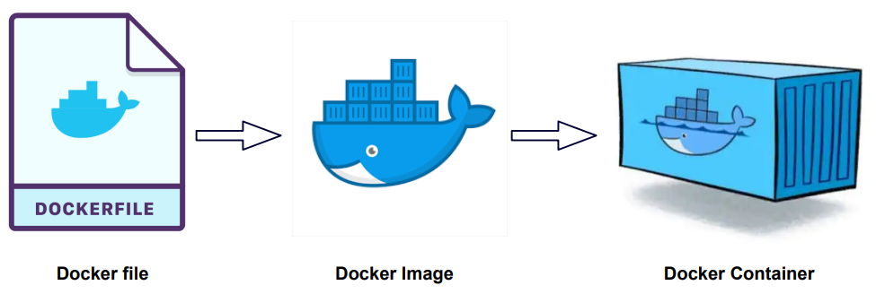
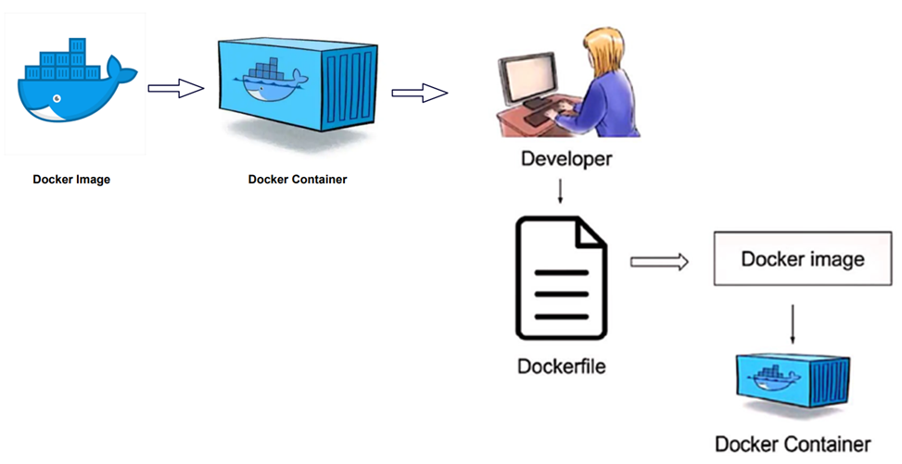
Docker Desktop
How to Create Docker Images?
A Docker image contains everything that is needed to run an app. Most times, we create a Docker image by using a parent image which serves as a base. Then we add our app and whatever else it needs on top of that. And you end up with the final image, built specifically for your app.
There are two ways of creating a Docker image:
The first way is to create them using a Dockerfile. A Dockerfile contains a set of instructions that runs on top of the parent image and creates an intermediate container for every instruction. After completion of an instruction, the context is sent forward for the next instruction.
The second way is by creating the image from a container. We create a container of an existing image. We run commands inside the container that can perform tasks like copy files, installing packages, etc. When we are making these changes to a container, its environment is different from what the container was created with.

Slide 18
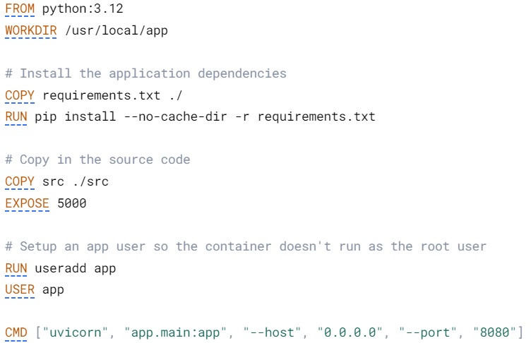
Docker Desktop
How to build a Docker image from Dockerfile
What Is Dockerfile?
A Dockerfile is a text-based document that's used to create a container image. It provides instructions to the image builder on the commands to run, files to copy, startup command, and more.
As an example, the following Dockerfile would produce a ready-to-run Python application:

Slide 19
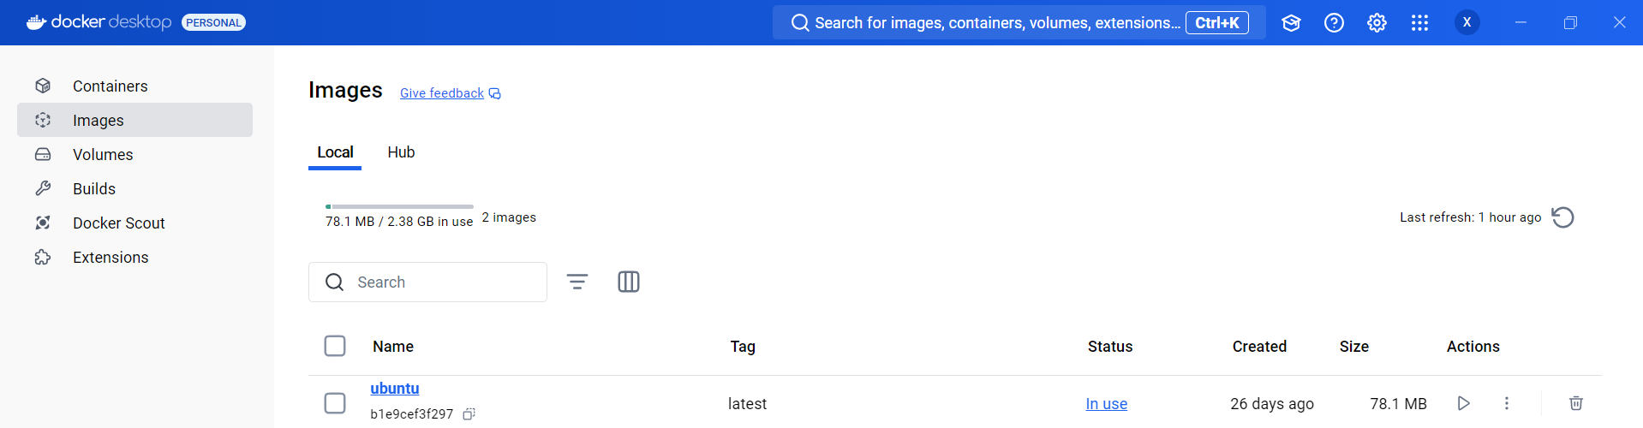
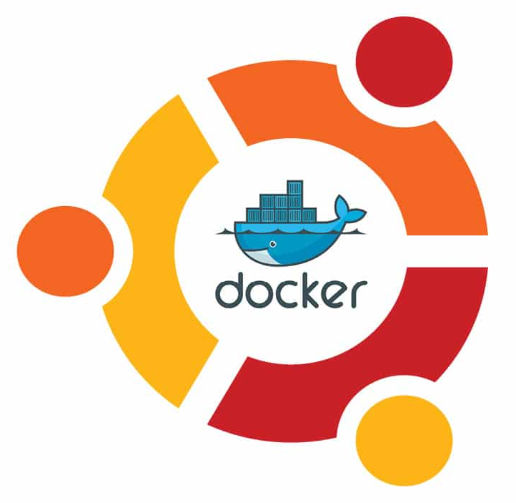
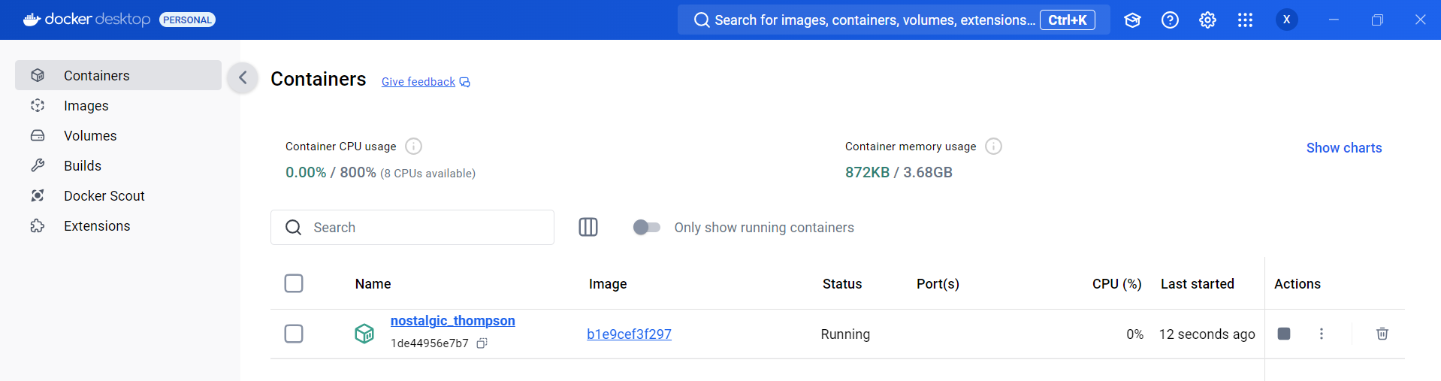

Docker Desktop
Images and Containers
Docker Desktop is a containerization application that allows users to build, share, and run containerized applications and microservices.
Images
Containers (built from Ubuntu image: b1e9cef3f297)
Ubuntu Image
Container

Slide 20
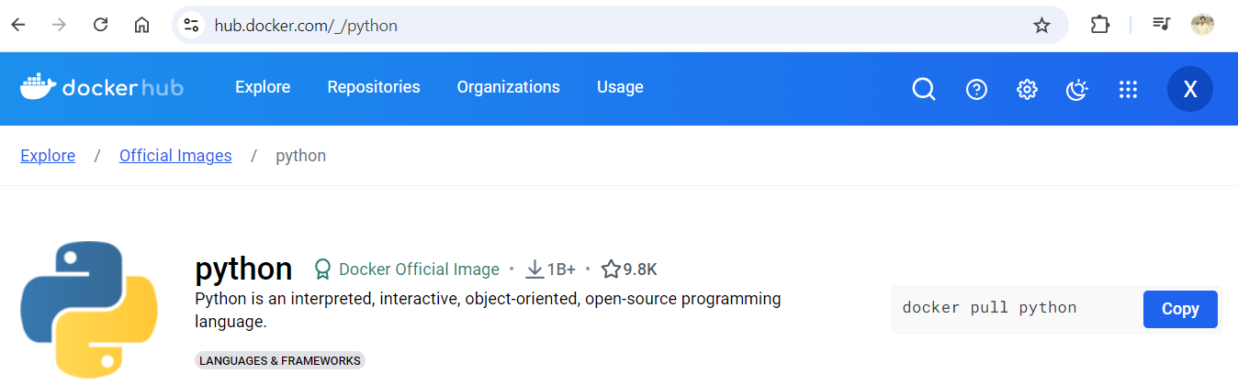
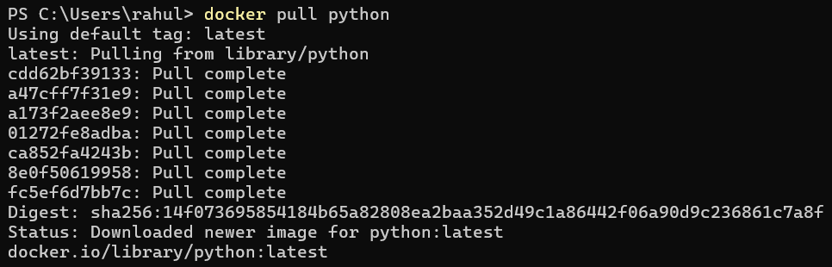
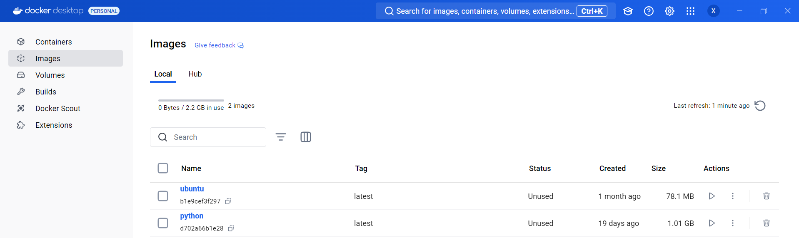
Docker CLI
Introduction
Docker CLI (Command-Line Interface) is a tool that allows developers and system administrators to interact with the Docker Engine. This includes building images from Dockerfiles, running containers from images, managing container networks and volumes, and interacting with the Docker registry.
Basic commands
docker pull : The first command we will try is to pull a public docker image from Dockerhub. This will pull the latest docker image from the DockerHub. The image will be stored in our local system. We can specify specific tags if we want to pull older versions of the image. If no TAG is specified, it is considered at the latest.

Slide 21
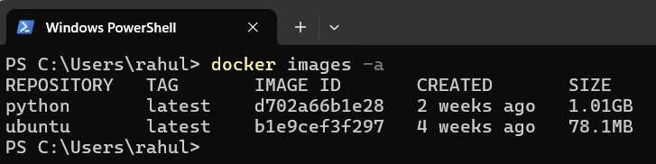
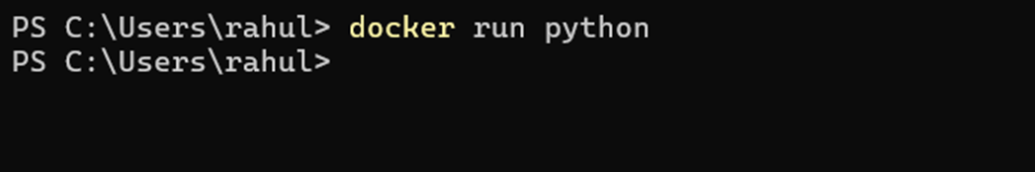
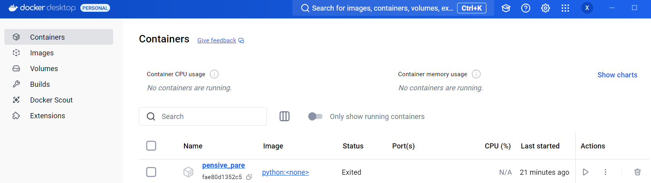
Docker CLI
Basic commands
docker images: We can see all the images in our local system by using the docker images command. Every image gets an IMAGE_ID that can be seen in the output of this command. The -a flag is used to view all the images available on the local machine.
docker run: Once the docker image is pulled we can run them as a container.
docker ps: We can list the containers using the docker ps command. This will show us the state of the container — Running, stopped, exited, etc. Every container also gets a CONTAINER_ID as we get for an image. The -a flag is used to list all the containers on the local machine.

Slide 22
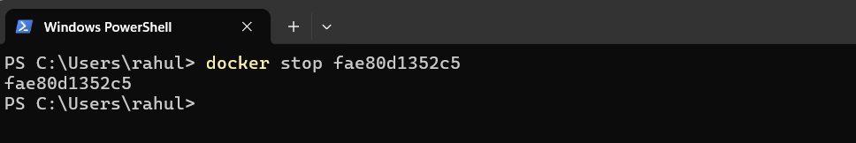
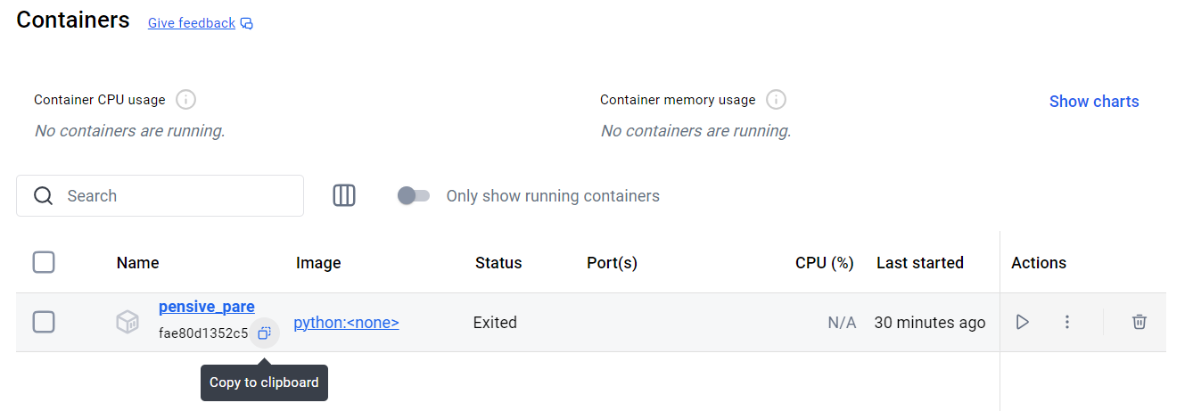
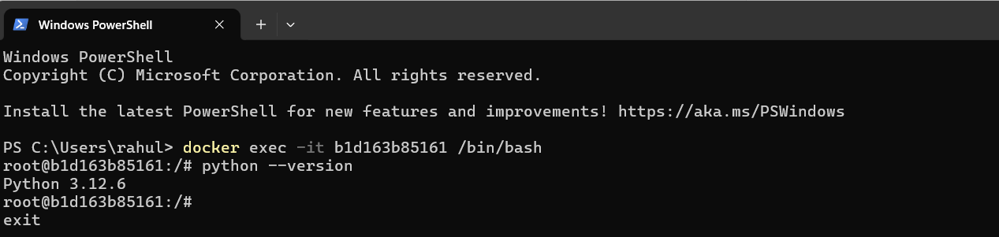
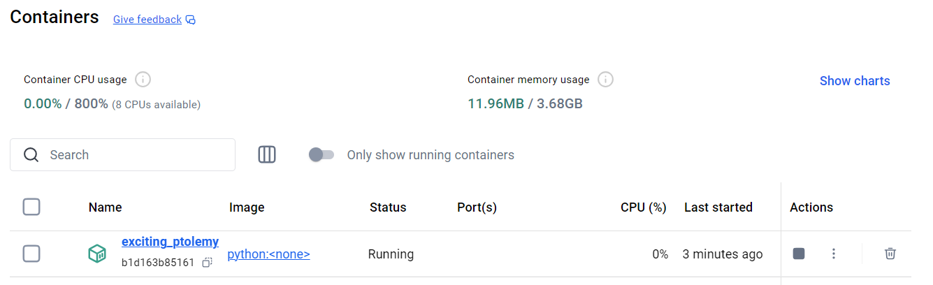
Docker CLI
Basic commands
docker stop: We will now stop our running container. We will pass the CONTAINER_ID to stop the container. The container goes into an EXITED state after it is stopped.
docker exec: We can get inside a docker container and access the terminal of the container using the exec command. The -it command states we will use interactive mode to connect to the bash shell of the container.

Slide 23
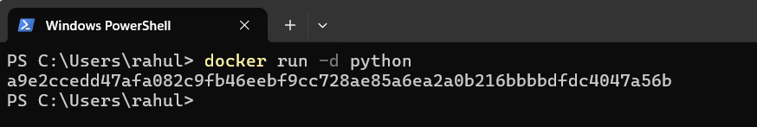
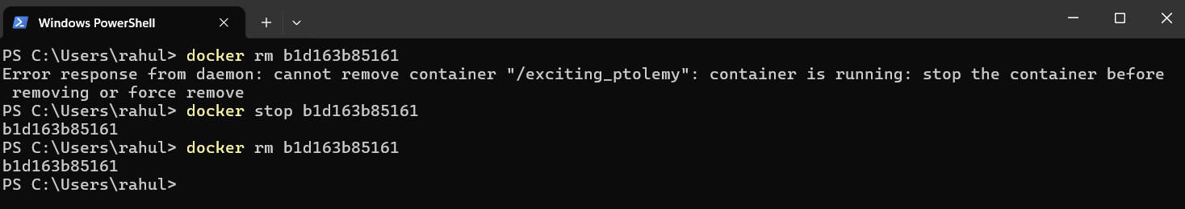
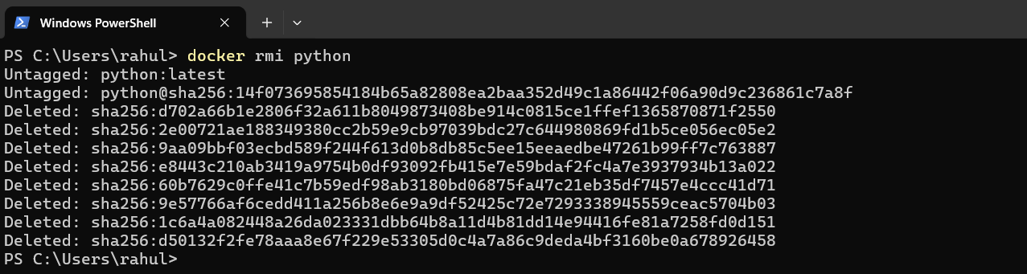
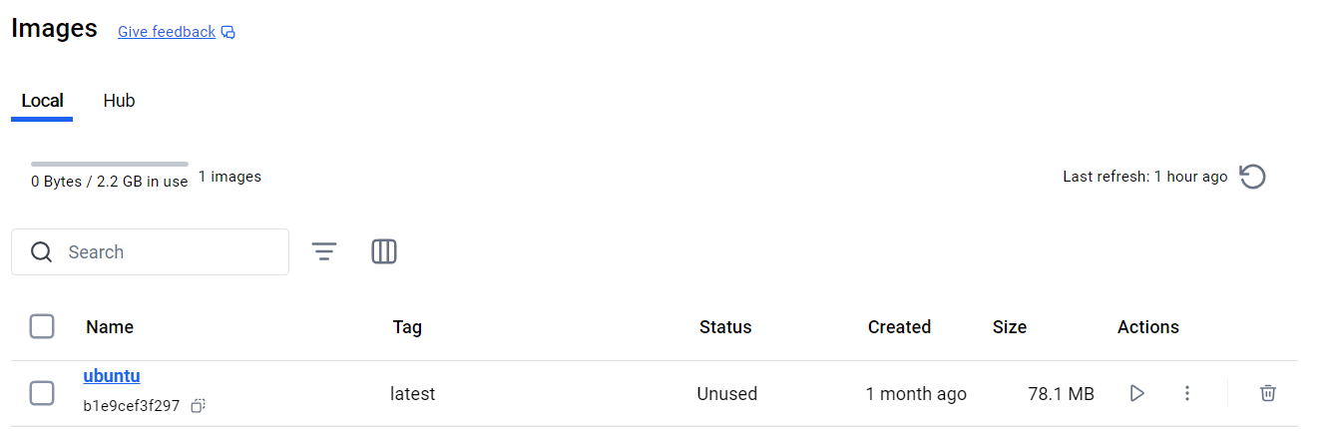
Docker CLI
Basic commands
docker run (as a daemon): We can run a container in the background as a daemon using the -d flag. This will make the container run in the background. On running the docker ps command we can see the container as up and running.
docker rm: To remove containers we need to stop them first and then remove those. A running container cannot be removed on the fly. It should be stopped. Below is an example of the same.
docker rmi: To remove the docker image from the local we use the docker rmi command. Again, this comes with the restriction that if a container is used referring to the image, the image cannot be removed.

Slide 24
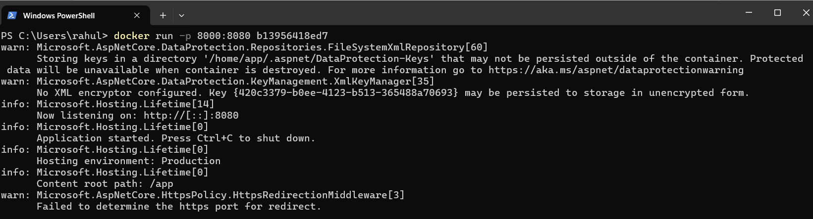
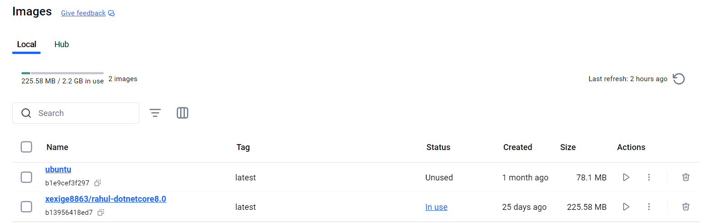
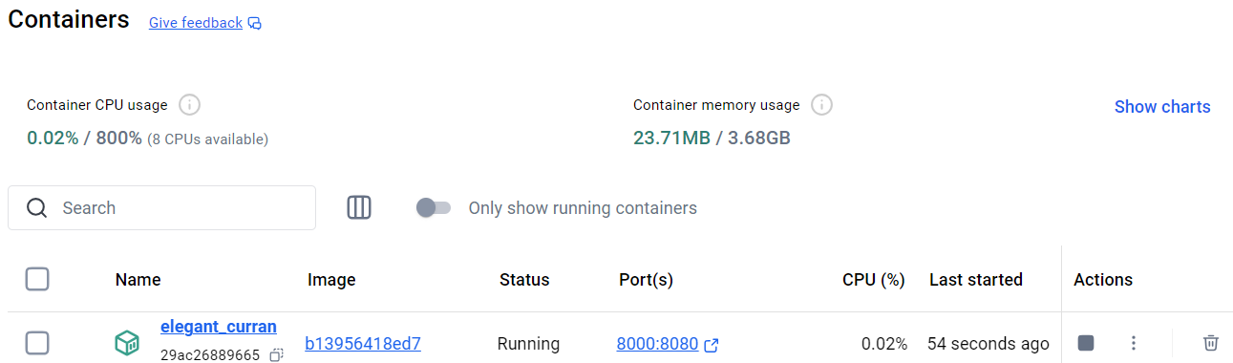
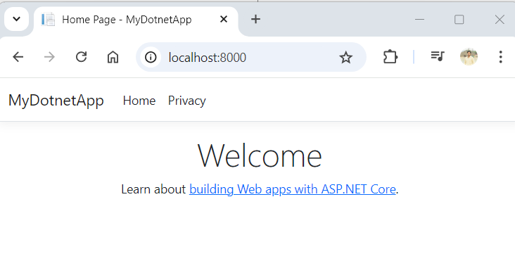
Docker CLI
Basic commands
docker run (port mapping): There is a requirement where want to run the application externally on some port. Say, in our example the .NET Core Application container runs on TCP port 8080 (HTTP). We want this .NET Core Application container to run on port 8000 for some application purposes. In that case, we should be able to run the container on port 8000 of our local machine and map that to container port 8080. The -p flag helps us in port forwarding.

Slide 25
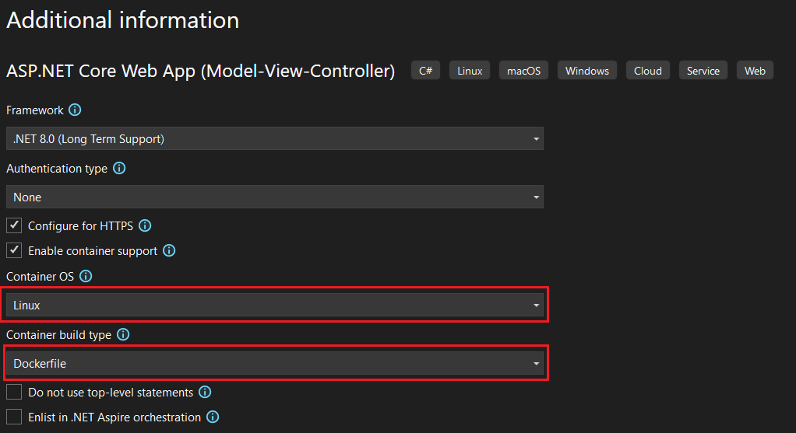
Create Dockerfile
.NET application with Dockerfile
Create a .NET application with Dockerfile: A Dockerfile is a script that contains instructions for building a Docker image. Create a file named Dockerfile (Note: Dockerfile without any extension) in your project directory
Visual Studio 2022 --> Create Project --> Enable container support

Slide 26
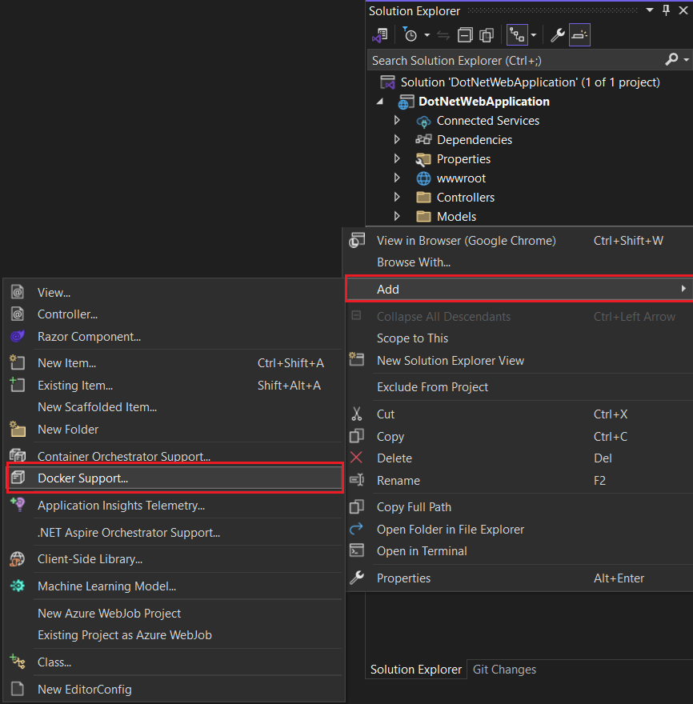
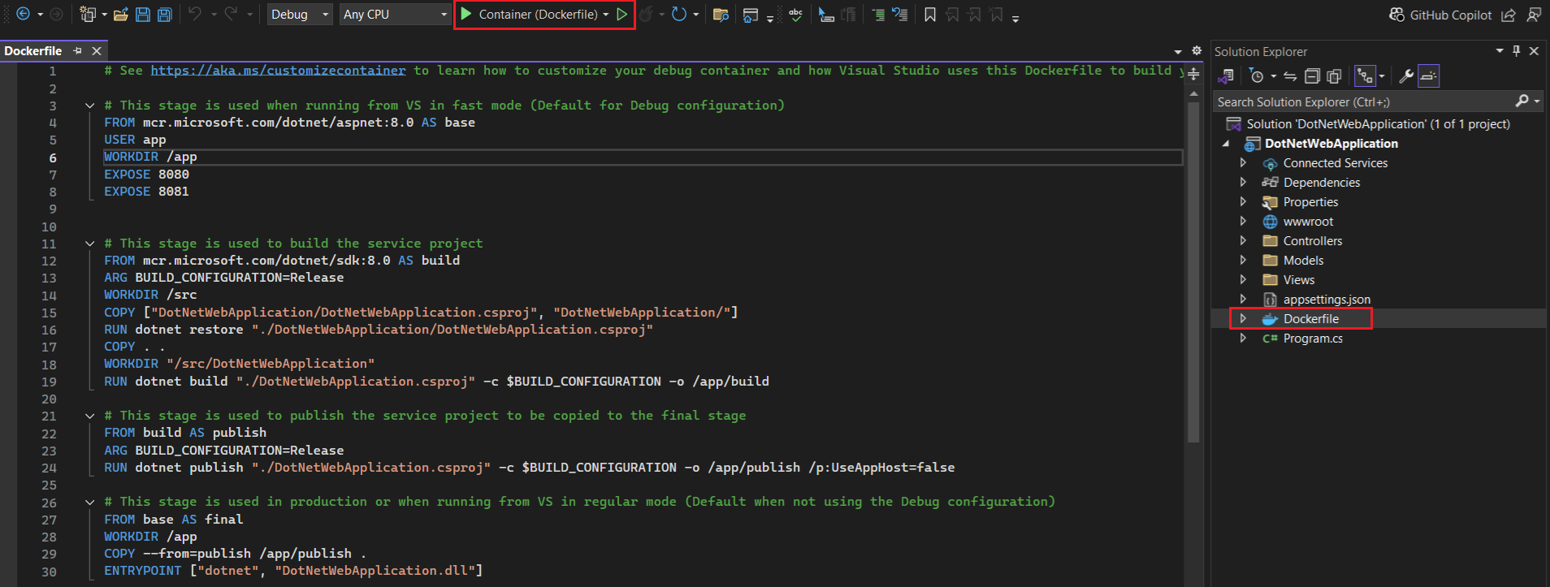
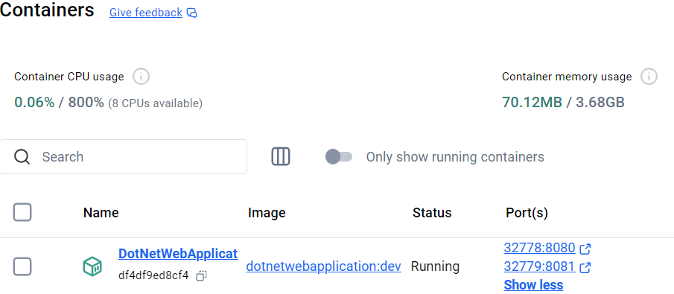
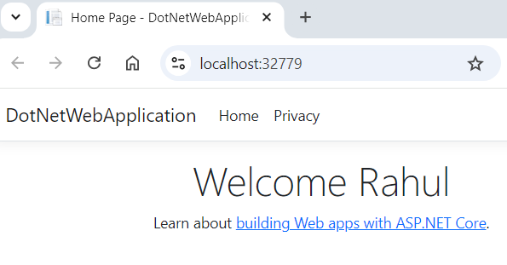
Create Dockerfile
Manually add the Dockerfile
Create a .NET Application with Dockerfile

Slide 27




Docker Hub
Prerequisites
You need to have a Docker Hub account (https://hub.docker.com)
Ensure you're logged in to Docker Hub from the command line

Slide 28


Docker Hub
Create repository in Docker Hub
Go to the Repositories Section and click the Create Repository button
Create repository and Fill in the Repository Details

Slide 29



Docker Hub
Create image
Create a Docker image tagged as username/repositoryname:tagname to specify both the repository and the version tag.
Open PowerShell or Command Prompt and navigate to the root folder where the Dockerfile is located. Then, run the following command.

Slide 30




Docker Hub
Push the image to DockerHub
Open PowerShell or Command Prompt and run the Docker commands To push a new tag to this repository:

Slide 31



Docker Hub
Pull the image from DockerHub
Search the image in Docker Hub (https://hub.docker.com/)
Execute the Docker Pull Command (docker pull rahulpal93/dotnetwebapplication:v1.0) and follow the instructions

Slide 32




Docker Hub
Run the image pulled from Docker Hub in a container
Run the image in container with port mapping

